Slide 1
ERAA 2022 Stakeholder workshop: Methodological Insights
11th of May 2022

Slide 2
Today’s Agenda : focus on methodologies
Part 1
Introduction
  Introduction and feedback from last public workshop and the call for evidence
  ERAA scenarios and main steps
Methodologies #1
  Multi-year approach for the EVA step
  Price cap determination
  Iterative capacity approach of “with CM” scenario
Part 2
Methodologies #2
  Explicit DSR modelling and expansion potentials
  Flow based Market Coupling domains
  Flow factor competition & curtailment sharing
Conclusions & next steps
1
6
2
7
8
3
4
5

Slide 3
Introduction
Kristof Sleurs,
ERAA Steering Group Convener

Slide 4

Background
ERAA is an ENTSO-E legal mandate, which aims to understand how the rapid changes to our energy system will affect security of supply.
It is a full pan-European monitoring assessment of power system resource adequacy, based on a state-of-the-art, globally unparalleled probabilistic analysis looking up to a decade ahead.
Stepwise implementation of the ACER methodology already began with ERAA 2021, and aims for a full target methodology to be applied as of ERAA 2024.
ERAA 2022 aims to be an effective tool to identify adequacy risks, and includes an enhanced Economic Viability Assessment, more specific representation of demand response, and Flow-Based market coupling incorporated in the central reference scenarios.
By proactively and factually identifying any system adequacy challenges, ERAA supports decision-makers in ensuring secure, affordable and sustainable energy to citizens and industries.

Slide 5






Call for evidence on preliminary input data
Closed on 5 April with participation of 11 stakeholders
Main drivers of the feedback:
  Fit-for-55 objectives
  Impact of the current Russia/Ukraine conflict
Economic parameters (including fuel & co2 prices
Demand profiles
Stakeholders commented on
Transfer capacities & CNECs
RES trajectories
Climate
Thermal capacities

Slide 6
Feedback summary & ENTSO-E actions (1/2)
 | Feedback Summary | ENTSO-E Actions
Demand profiles | TY 2027 and 2030 levels underestimated | NL, DE and BE demand projections updated to comply with new national plans
RES trajectories | Not ambitious enough in relation to Fit-for-55 | Increase in RES for DE, NL, PL, BE
 | Russia/Ukraine conflict not reflected in trajectories | Not reflected centrally in the dataset - use of best data available Exchanges between Russia and Finland set to zero
Thermal capacities | Updates of national plans considering latest targets and Member States decisions | Coal projections updated in Germany (-20 GW coal/lignite in 2030)
 |  | Nuclear phase-out updated in Belgium (+2.3 GW nuclear in 2030)
Climate data | Agreement overall, identified overestimated wind capacity factors (IE, UKNI) | Wind capacity factors fixed in final dataset

Slide 7
Feedback summary & ENTSO-E actions (2/2)
Economic Parameters (fuel, CO2 Prices, Mothballing & Life extension costs)
Other Updates:
General agreement with the proposed values
Sensitivities on fuel and CO2 prices proposed -> under consideration
Identified inconsistencies (NTCs, other data) fixed in final dataset
Updates in thermal capacity in Italy following CM auctions (+2 GW)
Correction in coal capacity in Spain, TY2024 (0.4 GW)

Slide 8
ERAA process
Kristof Sleurs,
ERAA Steering Group Convener

Slide 9
The ERAA – A multi-step and iterative process
National Estimates & Central Assumptions
Data
EVA step
Adequacy step
Without CM
Updated installed capacities
With CM
CM capacity adaptations
Adequacy Step
Iterations

Slide 10
Ready for the simulations
 | 2022
 | Mar | Apr | May | Jun | Jul | Aug | Sep | Oct | Nov
Model Preparation
Flow-based domains
Central scenarios
Simulation start
Sensitivities & reruns
Results analysis and report preparation
Workshop on Assumptions & principles
Webinar on results and consultation
Stakeholder consultations
Call for Evidence
Updated data release
Final report
publication
Legend
Preparations
Simulations
Analysis
Stakeholder Interactions
Milestone

Slide 11
Multiyear Economic Viability Assessment: methodology
Felix Böing
50 Hz & ERAA expert

Slide 12
A multi-year EVA for more robust results
Pan-European generation portfolio optimization over the horizon based on a total system costs minimization approach
Foresight for subsequent years is considered for (dis)investment decisions
“Stochastic” Multi-Year: more than one Climatic Year (CY) simultaneously
Target years and “gap” years in the ERAA modelling horizon
2024
2025
2026
2027
2028
2029
2030
Target Year (incl. adequacy run)
Gap year

Slide 13
A multi-year EVA for more robust results
Benefits
Accurate entry/exit decisions of market capacity over a longer horizon thanks to
  Consideration of future cash flows
  Multiple entry/exit decision variables incl. (de-)mothballing & life extension
Challenges
  High complexity
  Consistency with the economic dispatch problem (adequacy run)
  Consideration of years beyond the target horizon (till 2030)
  Gap years

Slide 14

The EVA models likely investor decisions
Technologies | Decommissioning | (De-)mothballing¹ | Life-extension¹ | New Entry
Hydro/RES³
Gas
Nuclear⁴
Lignite/Coal/Oil
DSR
Batteries²
¹ New decision variables
² New technology
³ Investments driven mostly by subsidies and policy targets. In addition, investment cost & potential are site-specific and hard to represent appropriately in a European-wide investment model
⁴ Policy units

Slide 15
Cashflows of 3 units and underlying assumptions
Unit A:
Entry / life extension
Unit C: Exit
Remaining
life-time considerations
2024
2025
2026
2027
2028
2029
2030
Unit B: Mothballing
Unit B:
De-mothballing
CAPEX
FOM
VOM
Revenues

Slide 16
Gap years are also modelled in the EVA for more robust results
Continuity of the horizon
ERAA 2022 focuses on 4 non-consecutive target years within the 7 years horizon 2024 – 2030
Full dataset available for the 4 target years: 2024, 2025, 2027, 2030
Years beyond 2030 accounted as repeating cash flows of 2030 up to end of lifetime of units
Fitting data to the gap years
Data | 2024 | 2025 | 2026 | 2027 | 2028 | 2029 | 2030
NGC¹
NTC²
Demand
RES CF³
Hydro Inflows
Fuel & CO₂ price
CHP revenues
Target Year
Specific data available
No fitting needed
No fitting needed
No fitting needed
Taken from previous TY
Linear interpolation
¹ NGC: Net Generation Capacities (all technology types incl. thermal, RES, batteries, DSR etc.)
² NTC: Net Transfer Capacities on cross-border interconnectors
³ RES CF: Capacity Factors for RES generation (e.g. solar PV, wind on-shore etc.)

Slide 17
A stochastic EVA is chosen but the # of possible Climatic Scenarios is a challenge
A climatic scenario (CS) is a sequence of climate years (CY - A,B,C in the example below) applied on the modelling horizon
The stochastic approach accounts for all CSs simultaneously and provides a single solution
2024
2025
2029
2030
A
A
A
A
CS X
A₃
Challenges
High complexity (Optimisation problem size)
→ temporal decomposition
→ Reduction of CS (Clustering of CY)
B₁
CS Y
B
B
B
B
CS Z
C
C
C
C
1 Solution

Slide 18
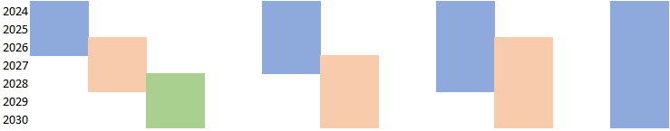
Gaining efficiency with a rolling horizon temporal decomposition
The complex global optimization problem is decomposed in multiple sub-problems.
Depending on the complexity of the EVA model over 7 years horizon, the problem can be divided in multiple rolling horizon steps (with overlap years).
3 Steps of
3 years horizon
(1 year overlap)
7 Steps of
2 year horizon
(1 years overlap)
1 Step of
7 years horizon
7 Steps of 1 year horizon
(0 years overlap)
Reduced complexity of the optimization problem
Reduced accuracy of entry/exit decisions

Slide 19
Gaining efficiency by selecting and clustering Climatic Scenarios
7 TYs
7 TYs
35 Climatic years
35^7 CS
35 Climatic scenarios
35 CS
7 TYs
CS 1: 1987 … 1991 … 1984 … 1995 …
CS 1: 1987 … 1987 … 1987 … 1987 …
CS 2: 1999 … 2010 … 2005 … 2015 …
CS 2: 1988 … 1988 … 1988 … 1988 …
…
…
3 Climatic scenarios
3 CS
CS 1: 1987 … 1987 … 1987 … 1987 …
CS 2: 2009 … 2009 … 2009 … 2009 …
…
CS
Reduction
CS/CY
Clustering
Start:
A climatic scenario (CS) is a sequence of climate years that covers the multi-year horizon
35 climatic years in 7 target years = 35^7 combinations
(i.e. climatic scenarios)
First Simplification: CS Reduction
One climatic scenario (CS) consists of 1 CY instead of 7 different CY
Second Simplification: CS/CY Clustering
EVA results for one target year¹ are calculated with all CY
The EVA (dis)investment decisions of each CY are evaluated in economic dispatch simulations for all other 34 CY
→ total system costs for non-optimal expansion plans
Minimum distance clustering to find three representative CYs
Weighting of CY in EVA based on the clustering
¹ To reduce the problem size of climatic scenario selection, we focus on a single target year (2030 - Highest RES penetration) to select the representative climatic years and reduce the number of blocks per day.

Slide 20
Price Caps
Felix Böing
50 Hz & ERAA expert

Slide 21
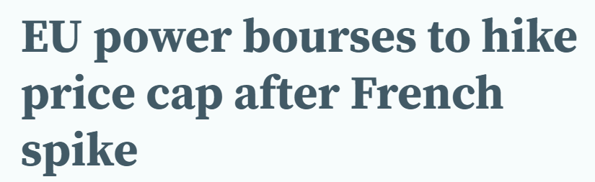
Price caps in the day-ahead market are dynamic and increase after scarcity events
Price cap evolution depends on the market situation
The value of the price cap is crucial for scarcity revenues and thus for des(investment) decisions
For illustrative purposes

Slide 22
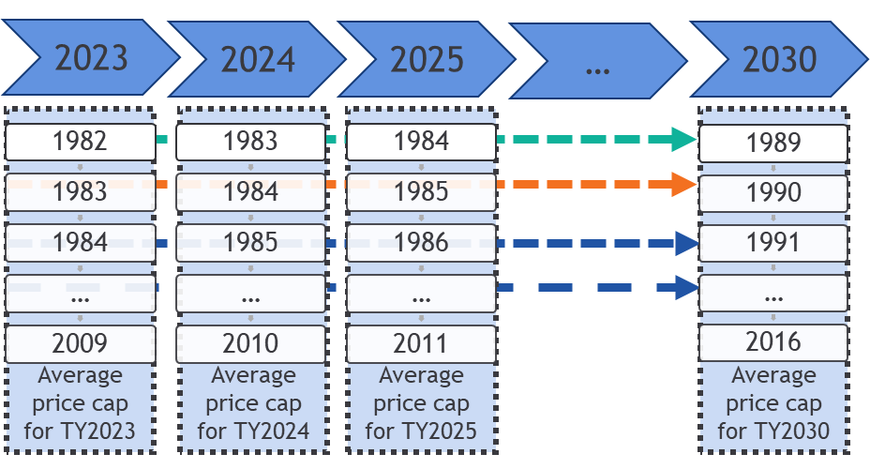
Calculation of representative price cap values for each TY
Principles of methodology
  Pre-Processing step before EVA simulation run
  Economic Dispatch on National Estimates 2025
  Simulated over 8 consecutive climate years
    Starting value: 4 k€/MWh in 2023
    Increase of the price cap based on simulated price spikes
Result
  One single price cap value per target year
Dynamic increase of price cap
Mean for TY2024
Mean for TY2025

Slide 23
Price cap - summary
Importance of price caps on Adequacy Studies
Impact of price caps is significant on the calculation of revenues, e.g. OCGT units
Direct modelling of dynamic price caps in the optimization problem for ERAA 2022 is quite challenging, thus an approximation is proposed
Implementation solution for ERAA 2022
Computational complexity is managed by implementing the methodology on an Economic Dispatch model (and not on EVA), while the models are built on a single target year
Representative set of price cap values for the different target years, approximating the dynamic increase of the price cap instead of using one fixed value for the whole horizon

Slide 24
Capacity adaptations methodology for with CM scenario
Octave Pin
ENTSO-E

Slide 25
Focus on the with CM scenario
National Estimates & Central Assumptions
Data
EVA step
Adequacy step
Without CM
Updated installed capacities
With CM
CM capacity adaptations
Adequacy Step
Iterations

Slide 26
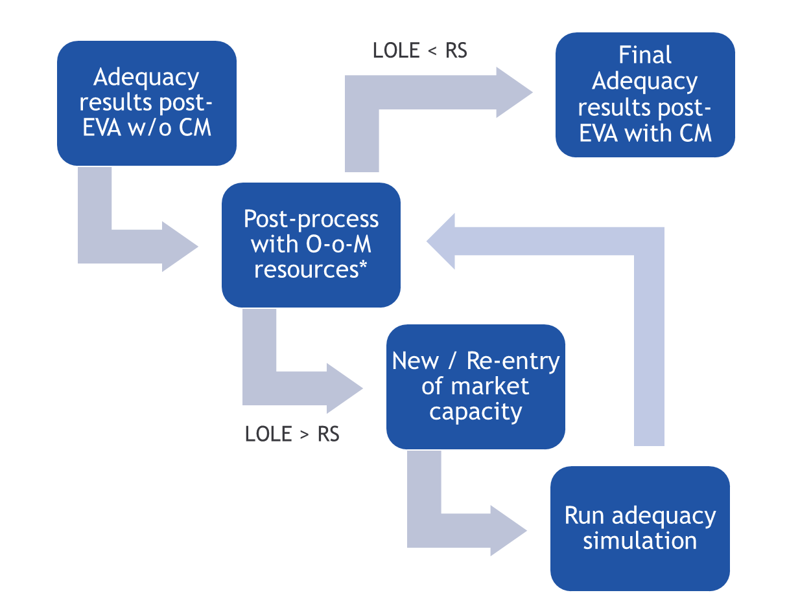
Capacity adaptation - An iterative process to meet the Reliability Standards
O-o-M resources for adequacy purposes is included in the capacity mix (post-process)
Triggered if:
  A country has an approved CM for the concerned TY.
  LOLE > RS after post-process
When RS not met, additional CM capacity is added.
Decision priority:
  Re-entry > New entry
  Low FOM > High FOM
O-o-M: Out-of-Market (interruptibility, strategic reserves)
CM: Capacity Mechanism
FOM: Fixed Operation and Maintenance cost
RS: Reliability Standards

Slide 27
Capacity adaptation of countries with CM have a cross-border contribution to countries with none
If ENS events are not simultaneous, capacity in one area can reduce scarcity in another.
Scenario without CM
With CM. Iter 1
Country: B
LOLE: 5 h
RS: 5 h
CM: yes
ΔP: +100 MW
Country | ΔP (MW) | LOLE (h)
A | +500 | 7
B | +200 | 5
C | 0 | 1
Country: B
LOLE: 6 h
RS: 5 h
CM: yes
Country: A
LOLE: 5 h
RS: 5 h
CM: yes
ΔP: +750 MW
Country: A
LOLE: 10 h
RS: 5 h
CM: yes
Country: C
LOLE: 1 h
ΔP: 0 MW
Country | ΔP (MW) | LOLE (h)
A | +650 | 6
B | +200 | 4.5
C | 0 | 1
Country: C
LOLE: 2 h
Scenario With CM
Final iteration
With CM. Iter 2

Slide 28
Explicit DSR
Octave Pin
ENTSO-E

Slide 29

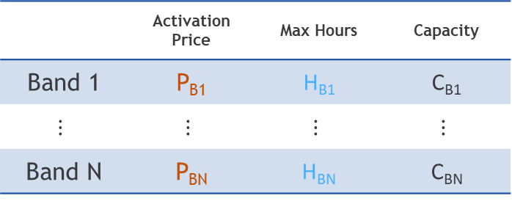

Explicit DSR (exDSR) resources modelled as multi-band generator
Composed by activation price [EUR/MWh] & capacity bands [MW]
Higher bands are activated only after lower bands
Explicit DSR can be dispatched multiple times a day up to their maximum daily operation hours
$$Price €/MWh_{e}$$
P_{B2}
 | Activation Price | Max Hours | Capacity
Band 1 | P_{B1} | H_{B1} | C_{B1}
$$⋮$$ | $$⋮$$ | $$⋮$$ | $$⋮$$
Band N | P_{BN} | H_{BN} | C_{BN}
P_{B1}
H_{B1}
H_{B2}
$$Time$$
T_{B1}
T_{B2}

Slide 30
Calculation of exDSR EVA expansion potential using available literature
TSO national estimates for DSR treated as policy units
EVA expansion potential
EVA expansion potential [MW]
…
TSO estimates
…
TY₁
TY_{N}
DSR investments in EVA need to reflect realistic techno-economic potentials
The EVA expansion potentials are associated with activation price bands, CAPEX and FOM values
Described later
DSR VOLL/CONE study
DSR National Study
Centralised approach
If not available
If not available
No DSR expansion potential will be considered for countries whose most recent VOLL/CONE study not retaining DSR as reference technology

Slide 31
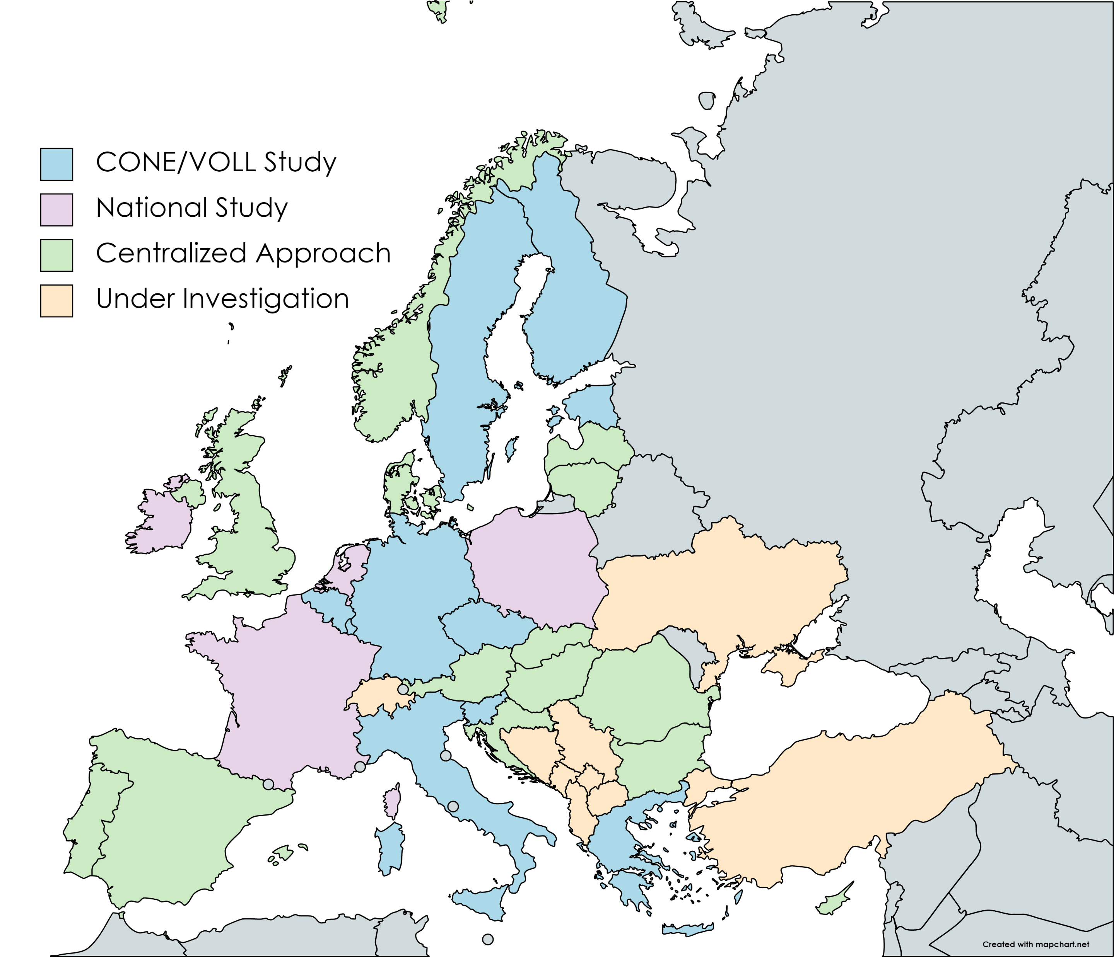
VOLL/CONE and National DSR studies are scarce
Preliminary figure. Data for DSR potentials are still under consolidation.

Slide 32
Updated centralized approach to estimate DSR potential
Historical sectoral consumption per sector¹ (TWh/year)
Equivalent sectoral Baseload (MW)
Sectorial operation hours per sector * (hrs/year)
Maximum technical DSR potential per sector (MW)
Flexible potential ratio for DSR **
35%
Subtract DSR already provided by TSOs in PEMMDB
Sectoral activation prices ² (€/MWh)
Sectoral FOM ³ (€/kW/y)
Sectoral CAPEX³ (€/kW)
¹ ^{Eurostat, 2019}
2 CEPA 2018, Study on the estimation of the value of lost load of electricity supply in Europe
3 Harmonized values from available VOLL/CONE studies
*Consumption assumed as baseload
** Assumption: calculated based on ratios between capacities in National studies and “Equivalent sectoral load” values

Slide 33
Flow Based Methodology
Lukas Galdikas
ENTSO-E
Paul Plessier
Rte & ERAA study team

Slide 34
What Flow-Based Market Coupling (FBMC) is
More accurate representation of network for market clearing
Flow-based Market Coupling enables more accurate dispatches and exchanges in a power system. It uses conditional scenarios to limit the dispatches based on simplified representation of how dispatch impact flows on critical network elements in the power system (hence “Flow-based”).
CNECs
PTDF matrix
RAM
E.g. if Net Position of Zone A is X_A1 and Net Position of Zone B is X_B1, then Net Position of Zone C can be between X_C1 and X_C2.
Critical network element | Contingency | Influence of the balance on each element (PTDF) |  |  |  | RAM (MW)
 |  | A | B | C | …
Line 1 | No contingency | -10% | 13% | -5% | … | 150
 | Contingency 1 | -15% | 10% | -10% |  | 120
 | Contingency 2 | -15% | 5% | -12% |  | 100
Line 2 | No contingency | 5% | 5% | -8% |  | 150
 | Contingency 3 | 1% | 20% | 2% |  | 50
Line 3 | No contingency | 2% | 6% | 17% |  | 400
 | Contingency 4 | 5% | 8% | 20% |  | 230
… | … | … |  |  |  | …
More references:
The Flow-Based Market Coupling in Central Western Europe: concepts and definitions. KU Leuven. 2015.
Power Flow Simulator (play in different complexity levels). TenneT. 2021
$$A⋅\left(−0.1\right)+B⋅0.13−C⋅0.05+…≤150 MW$$

Slide 35
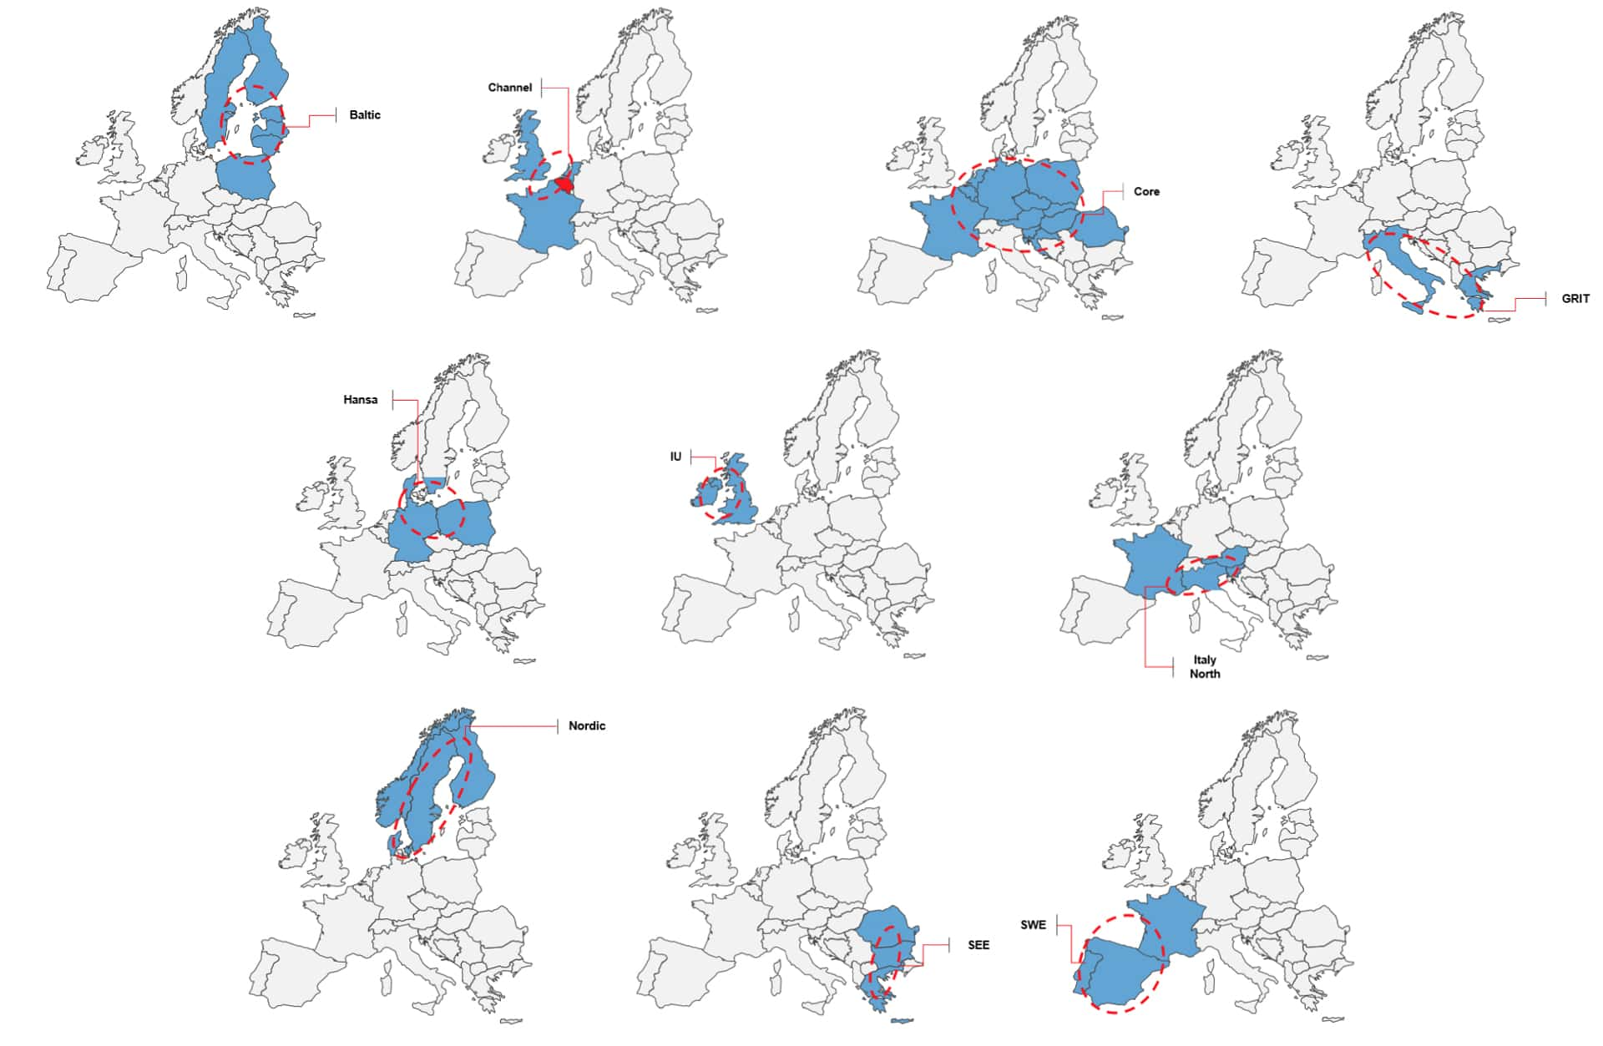


Why Flow-Based Market Coupling in ERAA
Representing future market arrangements more realistically
FBMC future expectations in Day-ahead markets:
CWE – operational
CORE* – in testing phase. Deployment in 2022.
Nordics – in testing phase. Deployment in 2023.
Legal: ENTSO-E aims to represent network and market arrangements in its studies as realistically as possibly. Hence, ERAA methodology foreseen a requirement to “<…> consider flow-based approach, where applicable”. This was endorsed by ACER.
*Core is an extension of CWE (continental west Europe) capacity calculation region

Slide 36
Methodologies to define Flow-Based domains
Two distinguished methodologies exist
Deriving FB domains from network
What it is: computing domains from future network models.
Pros: accurate and possible to reflect any changes in power system.
Cons: complex and time intensive work
Example: 1/ estimating spacecraft fuel consumption based on detailed physical model. 2/ Building weather models to create weather scenarios of the future climate.
Statistical analysis approach
What it is: preparing domains based on historical observations.
Pros: simpler process and hence less prone for mistakes. Faster to implement for first time.
Cons: impact of network developments missing.
Example: 1/ estimating vehicle fuel consumption based on historical records. 2/ Assuming weather scenarios based on historical observations.

Slide 37
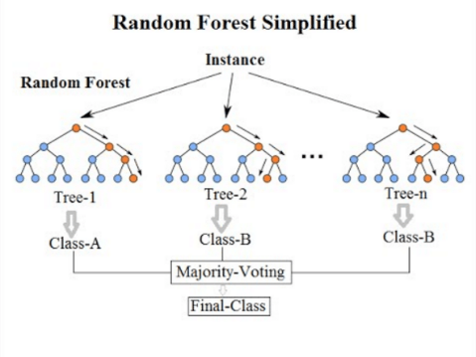
Methodology – Deriving FB domains from network
Core FB calculation
CNEC selection
0
1
Flow-Based domain computation and post-processing
Probabilistic capacity allocation
ERAA 2021 market simulation
Projection on TYNDP 2020 future grid
Clustering and representative hours
Remedial Actions optimization
4
0
2
3
6
Classification
5
Allocation to hours based on climatic variables scenario
Date | Day type
Climate Year 33, 10-27 (4h) | Winter
Climate Year 33, 11-09 (13h) | Winter
Climate Year 7, 09-14 (23h) | Winter
Climate Year 33, 06-14 (19h) | Summer
Typical day selection
Source : wikipedia
Random forest

Slide 38
FBMC in ERAA for closer representation of actual network and market arrangements
Conclusions
FBMC enables better representation of network in market simulations.
FBMC in ERAA better represents future market arrangements and therefore enhances adequacy simulation result representativeness.
FB domain computation is a work intensive task:
Future developments have certain impact on network exchanges
Large number of analysed scenarios (especially weather and RES generation)
Deriving FB domains from network is a target methodology for any prospective studies looking few years ahead.

Slide 39
Curtailment Sharing methodology
Zakaria EL Khelloufi
TenneT & ERAA study team

Slide 40
Euphemia algorithm - Background
Master problem
Volume indeterminancy
Price determination
PUN* search
Final Solution
Purpose
Solving the Day-Ahead European Market Coupling problem maximising social welfare
Outcome
Market clearing prices, matched volumes, and net positions for each bidding zone
Interconnector flows
EUPHEMIA runs a combinatorial optimization process structured in four different phases.
*PUN is defined as the average of the zonal prices weighted by zonal consumption

Slide 41
Volume Indeterminacy
ERAA performs the curtailment sharing following the Volume indeterminacy rules
The volume indeterminacy sub-problem seeks now to find one coherent solution from a set of equivalent solutions yielding the same social welfare with a focus on diffrent aspects.
1. Curtailment minimization
Mitigation measure that prevents PTOs* (price taking order) to be curtailed.
A fair distribution of curtailment across the involved markets.
2. Curtailment sharing
*PTOs: orders submitted at the price bounds set by the exchanges.

Slide 42
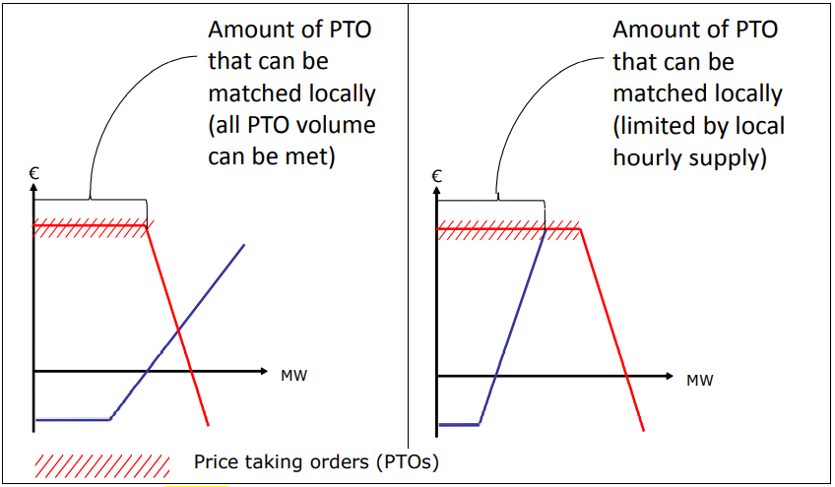
Curtailment minimization prevents order curtailment situations to be deteriorated
Aims at minimizing the curtailment of these price-taking limit orders, i.e. minimizing the rejected quantity of price-taking orders.
Enforcement of local matching of price-taking hourly orders with hourly orders from the opposite sense in the same bidding zone as a counterpart.
ERAA implementation
Adding LOCAL MATCHING constraint in the master problem for each bidding zone.

Slide 43
Flow factor competition leads to unfair distribution of ENS
All bidding zones are competing for the same capacity, but their competitive position is determined by the zonal PTDFs.
FBMC constraints
Priority is given to larger countries (high PTDF) in contrast to small countries (low PTDFs).
Countries with low ‘flow-factors’ are penalized with ENS to the benefit of countries with high ‘flow factors’.
ENS can be created for net exporting countries in order to find the lowest ENS for the FB area as a whole.

Slide 44


Penalizing curtailment ratio mitigates flow factor competition
1st stage -Penalizing non-acceptance of price taking orders
Aims to prevent flow factor competition (effectively treating curtailment outside of the welfare maximizing framework)
In order to prevent such cases, the rejected price taking demand orders are penalized (through their curtailment ratio) and added to the welfare maximization problem:
M * $Max Curtailment ratio$
rejected price-taking demand orders in a bidding zone
curtailment ratio =
Submitted price-taking demand orders in bidding zone
M: penalty term

Slide 45
Quadratic program for sharing curtailment
2nd stage -Volume problem
Aims to equalize curtailment ratios as much as possible among bidding zones willing to share curtailment.
The curtailment sharing is implemented by solving a dedicated volume problem, where all network constraints are enforced:
Min $Price taking demand order ∗ {Curtailment ratio}^{2}$
If the markets are curtailed to a different degree, the markets with the least severe curtailment (by comparison) would help the others reducing their curtailment, so that all the bidding zones in curtailment will end up with more equal curtailment ratios while respecting all network constraints.

Slide 46
Summary
Implementation in ERAA 2022
Solve the welfare maximization problem:
Minimization Energy Not Served + Penalizing the maximum curtailment ratio
Subject to:
Network constraints
Local matching constraint (curtailment minimization)
Solve the curtailment sharing problem:
Penalizing the squared curtailment ratio
Subject to:
Network constraint
Max curtailment ratio identified in previous stage

Slide 47
Conclusions & next steps
Kristof Sleurs,
ERAA Steering Group Convener

Slide 48
Don’t forget to join us for the next public webinars & workshops
Webinar “Preliminary input data”
Call for Evidence window opening
Webinar on “ERAA 2022 results”
Launching ERAA 2022 consultation
Webinar
“ERAA 2022 Methodological Insights”
Workshop
“ERAA 2022 Principles and Assumptions”
Webinar
“ERAA 2022 Methodological Insights –Part2”
Call-for-Evidence
window closure
Publication
09 March
17 March
5
April
Today
tbc
Summer
Early
November
Mid
November
Preliminary agenda:
Maintenance optimisation
Reserves modelling
Sources of scarcity

Slide 49
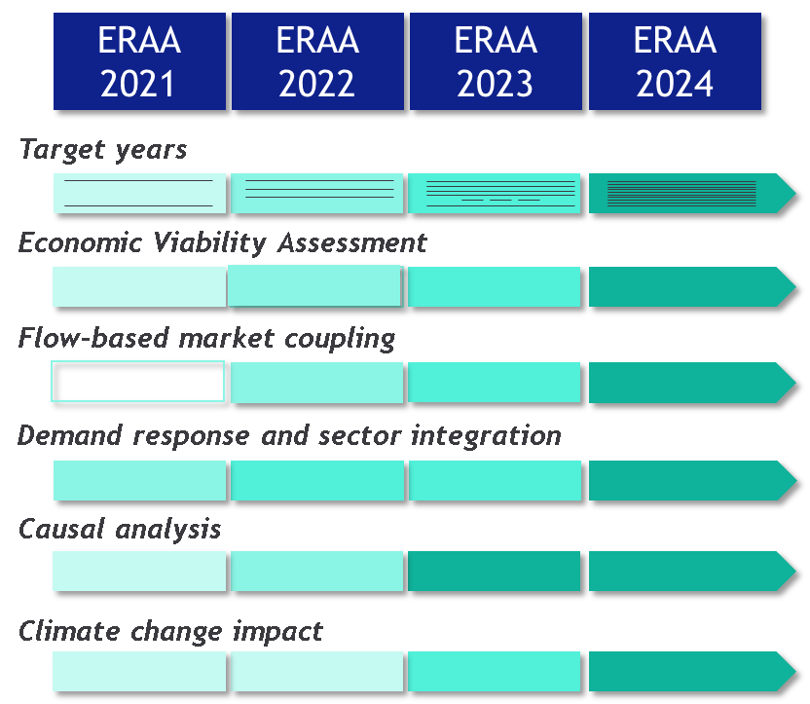
Key enhancements for ERAA 2022
Stakeholder interaction
Multiple consultations and webinars on input data, methodologies and results
Integrating views into ERAA 2022 and next ERAAs
Expanded methodology
Scenarios heading towards Fit for 55
Enhanced EVA with 4 years horizon
Flow-based in central reference scenarios
DSR, storage and electrolysers
CHP heat revenues and maintenance

Slide 50
Thank you for your attention
Cooperation
Coordination
Planning, cooperation and targeted measures are key for a secure electricity system.
Adequacy issues deeply interlinked; regional coordination is crucial.

